Slide 1
Digital Logic Design I CS1026
Paula.Roberts@scss.tcd.ie

Slide 2
Half-Adder
Basic rules of binary addition are performed by a half adder, which has two binary inputs (A and B) and two binary outputs (Carry out and Sum).
The inputs and outputs can be summarized on a truth table.
The logic symbol and equivalent circuit are:
Σ
Σ
A
Σ
A
C_{out}
B
C_{out}
B

Slide 3
Full-Adder
By contrast, a full adder has three binary inputs (A, B, and Carry in) and two binary outputs (Carry out and Sum). The truth table summarizes the operation.
A full-adder can be constructed from two half adders as shown:
Σ
Σ
Σ
Σ
A
A
A
Sum
Σ
B
B
C_{out}
B
C_{out}
A
Σ
B
C_{out}
C_{in}
C_{in}
C_{out}
Symbol

Slide 4
Complete Logic circuit for Full Adder

Slide 5
Full-Adder
Σ
Σ
1
Σ
Σ
0
Sum
1
A
A
Example
B
0
1
0
C_{out}
B
C_{out}
For the given inputs, determine the intermediate and final outputs of the full adder.
1
C_{out}
1
Solution
The first half-adder has inputs of 1 and 0; therefore the Sum =1 and the Carry out = 0.
The second half-adder has inputs of 1 and 1; therefore the Sum = 0 and the Carry out = 1.
The OR gate has inputs of 1 and 0, therefore the final carry out = 1.

Slide 6
Full-Adder
Notice that the result from the previous example can be read directly on the truth table for a full adder.
Σ
Σ
1
Σ
Σ
0
Sum
1
A
A
B
0
1
0
C_{out}
B
C_{out}
1
C_{out}
1

Slide 7
Parallel Adders
Full adders are combined into parallel adders that can add binary numbers with multiple bits. A 4-bit adder is shown.
A₄ B₄
A₃ B₃
A₂ B₂
A₁ B₁
C₀
A
B
C_{in}
A
B
C_{in}
A
B
C_{in}
A
B
C_{in}
C_{out}
Σ
C_{out}
Σ
C_{out}
Σ
C_{out}
Σ
C₄
C₃
C₂
C₁
Σ₄
Σ₃
Σ₂
Σ₁
The output carry (C₄) is not ready until it propagates through all of the full adders. This is called ripple carry, delaying the addition process.

Slide 8
Parallel Adders
The logic symbol for a 4-bit parallel adder is shown. This 4-bit adder includes a carry in (labeled (C₀) and a Carry out (labeled C₄).
Σ
1
2
3
4
1
2
3
4
Binary number A
4-bit sum
1
2
3
4
Binary number B
Input carry
C₀
C₄
Output carry
The 74LS283 is an example. It features look-ahead carry, which adds logic to minimize the output carry delay. For the 74LS283, the maximum delay to the output carry is 17 ns.

Slide 9
Devise a Truth Table for a 4-Bit Parallel Adder
What are the inputs?
What are the outputs?

Slide 10
Truth Table for a 4-bit adder
C_{n-1} | A_{n} | B_{n} | ∑_{n} | C_{n}
0 | 0 | 0 | 0 | 0
0 | 0 | 1 | 1 | 0
0 | 1 | 0 | 1 | 0
0 | 1 | 1 | 0 | 1
1 | 0 | 0 | 1 | 0
1 | 0 | 1 | 0 | 1
1 | 1 | 0 | 0 | 1
1 | 1 | 1 | 1 | 1

Slide 11
Comparators
The function of a comparator is to compare the magnitudes of two binary numbers to determine the relationship between them. In the simplest form, a comparator can test for equality using XNOR gates.
Example
How could you test two 4-bit numbers for equality?
Solution
AND the outputs of four XNOR gates.
A₁
B₁
A₂
B₂
Output
A₃
B₃
A₄
B₄

Slide 12
Comparators
IC comparators provide outputs to indicate which of the numbers is larger or if they are equal. The bits are numbered starting at 0, rather than 1 as in the case of adders. Cascading inputs are provided to expand the comparator to larger numbers.
COMP
A₀
0
A₁
A
A₂
A₃
3
Cascading inputs
A > B
A > B
A = B
A = B
Outputs
A < B
A < B
B₀
0
B₁
A
The IC shown is the 4-bit 74LS85.
B₂
B₃
3

Slide 13
Comparators
IC comparators can be expanded using the cascading inputs as shown. The lowest order comparator has a HIGH on the A = B input.
LSBs
MSBs
A₀
COMP
A₄
COMP
A₁
0
A₅
0
A₂
A
A₆
A
A₃
A₇
3
3
A > B
A > B
A > B
A > B
+5.0 V
A = B
A = B
A = B
A = B
Outputs
B₀
A < B
A < B
B₄
A < B
A < B
0
0
B₁
B
B₅
B
B₂
B₆
B₃
3
B₇
3

Slide 14
Decoders
A decoder is a logic circuit that detects the presence of a specific combination of bits at its input. Two simple decoders that detect the presence of the binary code 0011 are shown. The first has an active HIGH output; the second has an active LOW output.
A₀
A₀
A₁
X
A₁
X
A₂
A₂
A₃
A₃
Active HIGH decoder for 0011
Active LOW decoder for 0011

Slide 15
Decoders
Question
Assume the output of the decoder shown is a logic 1. What are the inputs to the decoder?

Slide 16
Decoders
IC decoders have multiple outputs to decode any combination of inputs. For example the binary-to-decimal decoder shown here has 16 outputs – one for each combination of binary inputs.

Slide 17
Question For the input shown, what is the output?

Slide 18
Decoders
X/Y
A specific integrated circuit decoder is the 74HC154 (shown as a 4-to-16 decoder). It includes two active LOW chip select lines which must be at the active level to enable the outputs. These lines can be used to expand the decoder to larger inputs.
A₀
A₁
A₂
A₃
CS₁
CS₂
EN
74HC154

Slide 19
Decoders
BCD-to-decimal decoders accept a binary coded decimal input and activate one of ten possible decimal digit indications.
A₀
A₁
A₂
A₃
Example
Assume the inputs to the 74HC42 decoder are the sequence 0101, 0110, 0011, and 0010. Describe the output.
Solution
All lines are HIGH except for one active output, which is LOW. The active outputs are 5, 6, 3, and 2 in that order.

Slide 20
BCD Decoder/Driver
Another useful decoder is the 74LS47. This is a BCD-to-seven segment display with active LOW outputs.
V_{CC}
The a-g outputs are designed for much higher current than most devices (hence the word driver in the name).
BCD/7-seg
BI/RBO
BI/RBO
BCD inputs
Outputs to seven segment device
LT
LT
RBI
RBI
74LS47
GND

Slide 21
BCD Decoder/Driver
Here the 7447A is an connected to an LED seven segment display. Notice the current limiting resistors, required to prevent overdriving the LED display.

Slide 22
BCD Decoder/Driver
The 74LS47 features leading zero suppression, which blanks unnecessary leading zeros but keeps significant zeros as illustrated here. The BI/RBO output is connected to the RBI input of the next decoder.
Blanked
Blanked
Depending on the display type, current limiting resistors may be required.

Slide 23
BCD Decoder/Driver
Trailing zero suppression blanks unnecessary trailing zeros to the right of the decimal point as illustrated here. The RBI input is connected to the BI/RBO output of the following decoder.
Decimal point
Blanked
Blanked

Slide 24
Encoders
An encoder accepts an active logic level on one of its inputs and converts it to a coded output, such as BCD or binary.
The decimal to BCD is an encoder with an input for each of the ten decimal digits and four outputs that represent the BCD code for the active digit. The basic logic diagram is shown. There is no zero input because the outputs are all LOW when the input is zero.
1
A₀
2
3
A₁
4
5
A₂
6
7
8
A₃
9

Slide 25
Encoders
Example
Show how the decimal-to-BCD encoder converts the decimal number 3 into a BCD 0011.
Solution
The top two OR gates have ones as indicated with the red lines. Thus the output is 0011.
1
0
1
A₀
2
0
1
3
1
A₁
4
0
5
0
0
A₂
6
0
0
7
8
0
0
0
A₃
9

Slide 26
Encoders
The 74HC147 is an example of an IC encoder. It is has nine active-LOW inputs and converts the active input to an active-LOW BCD output.
V_{CC}
This device is offers additional flexibility in that it is a priority encoder. This means that if more than one input is active, the one with the highest order decimal digit will be active.
HPRI/BCD
Decimal input
BCD output
74HC147
GND

Slide 27
Multiplexers
A multiplexer (MUX) selects one data line from two or more input lines and routes data from the selected line to the output. The particular data line that is selected is determined by the select inputs.
Two select lines are shown here to choose any of the four data inputs.
S₀
0
Data
select
1
S₁
D₀
Data
output
Question
Data
inputs
D₁
D₂
Which data line is selected if S₁S₀ = 10?
D₃
D₂

Slide 28
Demultiplexers
A demultiplexer (DEMUX) performs the opposite function from a MUX. It switches data from one input line to two or more data lines depending on the select inputs.
The 74LS138 was introduced previously as a decoder but can also serve as a DEMUX. When connected as a DEMUX, data is applied to one of the enable inputs, and routed to the selected output line depending on the select variables. Note that the outputs are active-LOW as illustrated in the following example…
Data select lines
Data outputs
Enable
inputs
74LS138

Slide 29
A
0
A
Demultiplexers
1
A
Example
Determine the outputs, given the inputs shown.
2
G
1
Solution
G
LOW
2A
The output logic is opposite to the input because of the active-LOW convention. (Red shows the selected line).
G
LOW
2B
Y
0
Y
1
Data select lines
Y
2
Y
Data outputs
3
Y
Enable
inputs
4
Y
5
Y
6
Y
74LS138
7

Slide 30

Parity Generators/Checkers
Parity is an error detection method that uses an extra bit appended to a group of bits to force them to be either odd or even. In even parity, the total number of ones is even (including the parity bit); in odd parity the total number of ones (including the parity bit) is odd. Used in keyboards, PCI bus, RAID Arrays.
Example
The ASCII letter S is 1010011. Show the parity bit for the letter S with odd and even parity.
Solution
S with odd parity =
11010011
S with even parity =
01010011

Slide 31
Parity Generators/Checkers
The 74LS280 can be used to generate a parity bit or to check an incoming data stream for even or odd parity.
Checker: The 74LS280 can test codes with up to 9 bits. The even output will normally be HIGH if the data lines have even parity; otherwise it will be LOW. Likewise, the odd output will normally be HIGH if the data lines have odd parity; otherwise it will be LOW.
Data inputs
Σ Even
Σ Odd
Generator: To generate even parity, the parity bit is taken from the odd parity output. To generate odd parity, the output is taken from the even parity output.
74LS280

Slide 32

Examples
Determine the Full Adder o/ps for the following i/ps
A=1, B=0, C_{in}=0
A=0, B=0, C_{in}=1
A=0, B=1, C_{in}=1
A=1, B=1, C_{in}=1

Slide 33
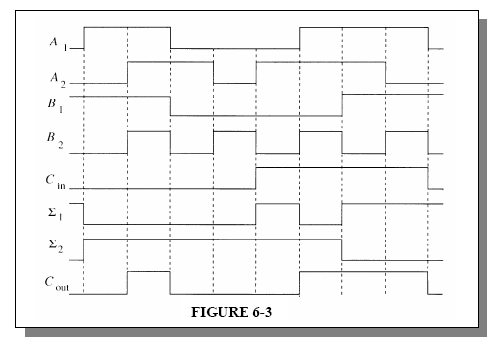
Examples
The input waveforms shown are applied to a 2 bit adder. Draw the waveform diagrams for the Sum and o/p Carry

Slide 34
Examples

Slide 35
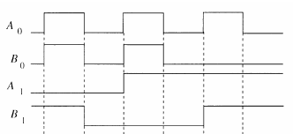
Examples
Draw the o/p waveform A=B
A0
A1
B0
B1
COMP
A
A=B
B

Slide 36
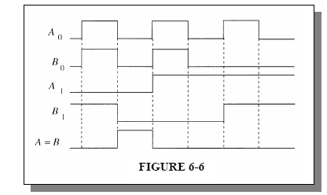
Examples

Slide 37
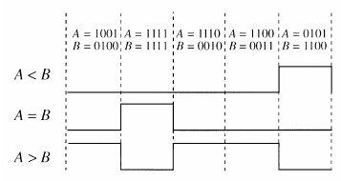
Examples
For the 4 bit comparator in the Figure, plot each o/p waveform for the i/p shown
COMP
A₀
0
A₁
A
A₂
A₃
3
A > B
A > B
Vcc
A = B
A = B
A < B
A < B
B₀
0
B₁
A
B₂
B₃
3

Slide 38
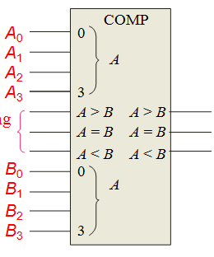

Examples
For each set of binary inputs to the comparator, calculate the o/p
A=1100 B=1001
A=1000 B=1011
A=0100 B=0100

Slide 39
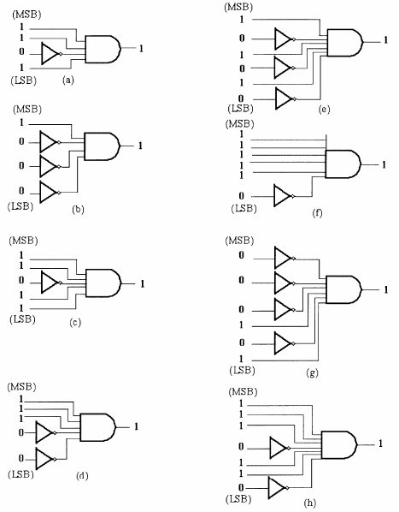
Examples
Show the decoding logic for each of the following codes if an active high (1) o/p is required
1101
1000
11011
11100
101010
111110
000101
1110110

Slide 40

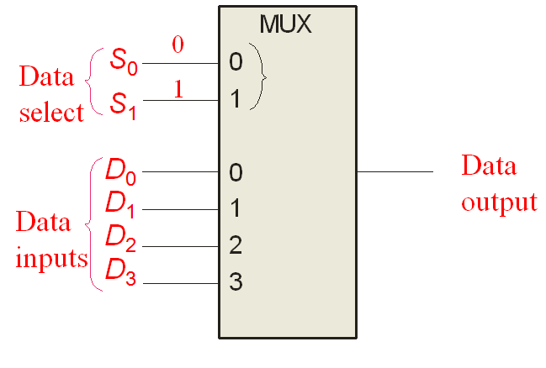
Examples
Determine the o/p of this MUX
D0=1, D1=1, D2=1, D3=0,S0=0, S1=1
Solution

Slide 41
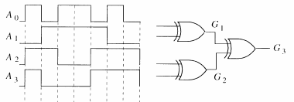
Examples
The waveforms shown are applied to the 4 bit parity logic. Determine the o/p waveform. How many times does even parity occur and how is it indicated. The timing diagram includes 8 bit times.

Slide 42
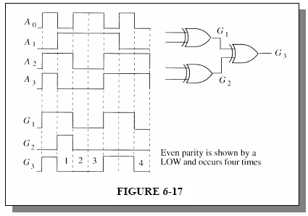
Examples

